Slide 1




Project EDDIE: Lake Ice Phenology
Carey, C.C., J.L. Klug, and D.C. Richardson. 1 April 2015. Project EDDIE: Lake Ice Phenology. Project EDDIE Module 1, Version 1. http://cemast.illinoisstate.edu/data-for-students/modules/ice-phenology.shtml.
Module development was supported by NSF DEB 1245707.

Slide 2
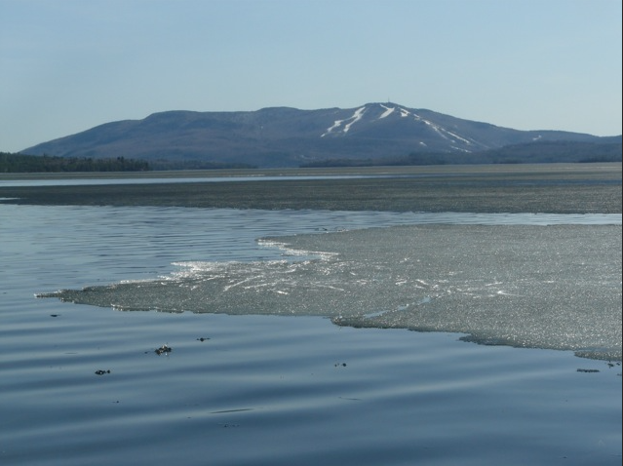
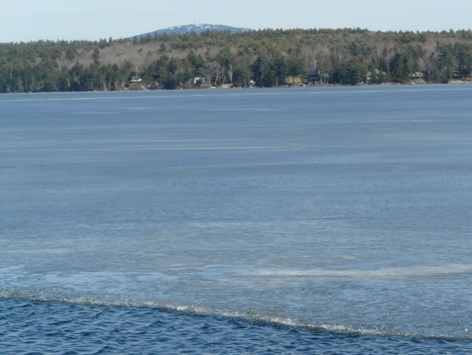
What is ice-off, anyway?
Photo credit: Midge Eliassen

Slide 3
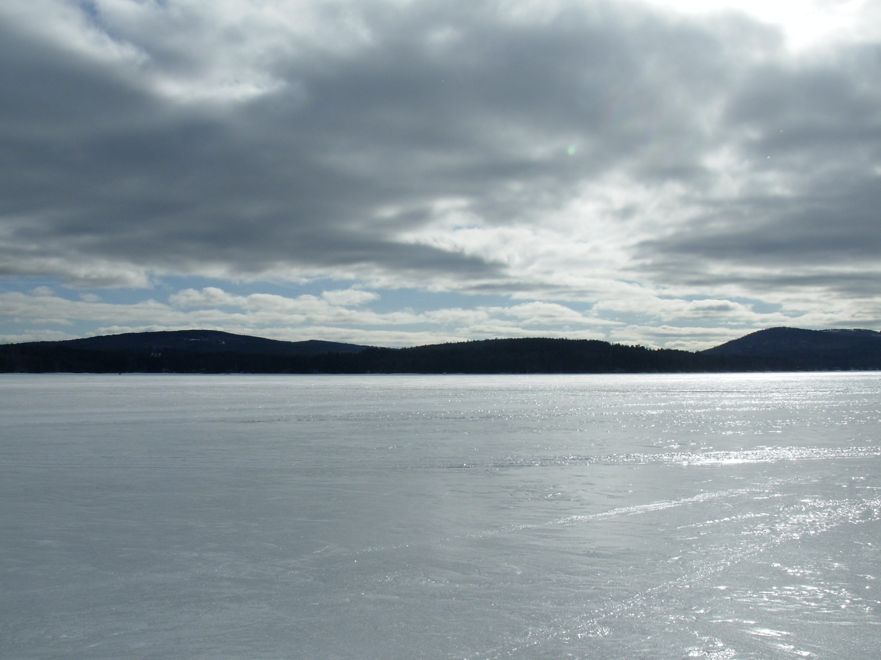
How does ice melt?
Photo credit: Midge Eliassen

Slide 4
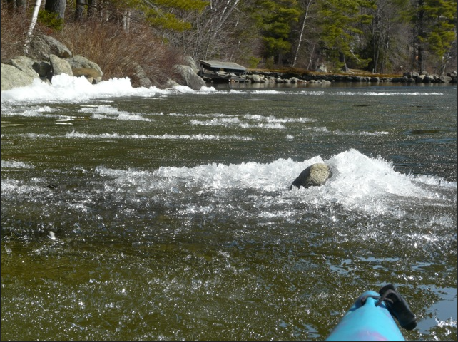
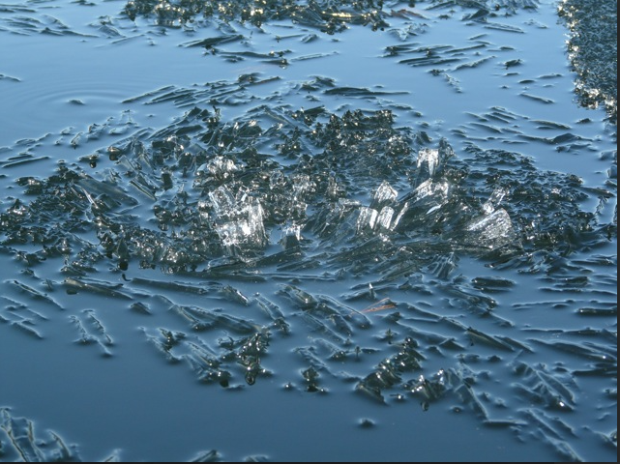
Ice candles
Photo credit: Midge Eliassen

Slide 5
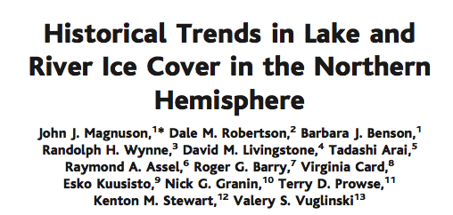
What was the proxy used for ice-out in Lake Constance in the Middle Ages?
Notes:
Monet painting!

Slide 6
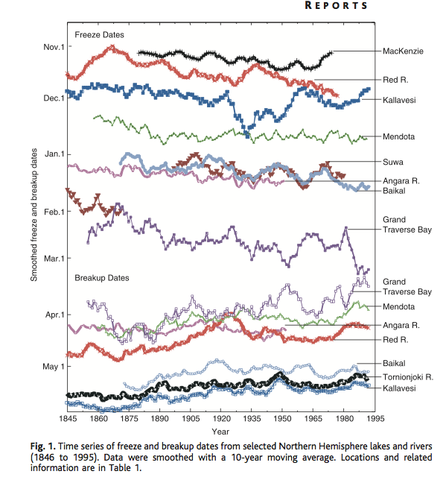
Magnuson et al. 2000

Slide 7
Why are changes in ice-off dates important to the biology of the lake?
Algae
Zooplankton
Abundance
Time

Slide 8
Why are changes in ice-off dates important to the biology of the lake?
Clearwater phase
Algae
Zooplankton
Abundance
Time

Slide 9
Why are changes in ice-off dates important to the biology of the lake?
respond to temperature
Clearwater phase
Algae
Zooplankton respond to photoperiod
Abundance
Time
Predict what is going to happen with climate change!

Slide 10
Why are changes in ice-off dates important to the biology of the lake?
respond to temperature
Clearwater phase
Algae
Zooplankton respond to photoperiod
Abundance
MISMATCH!!
Time

Slide 11
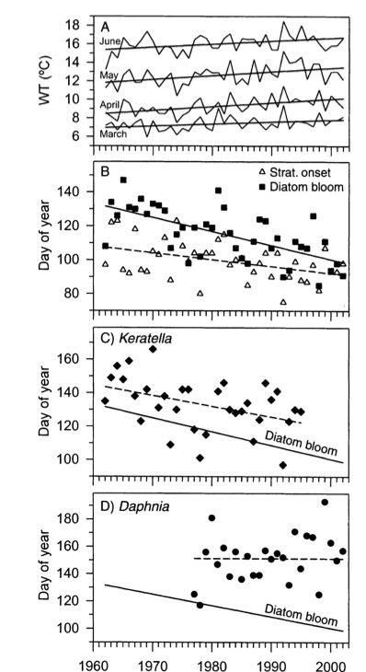
Winder and Schindler (2004)

Slide 12
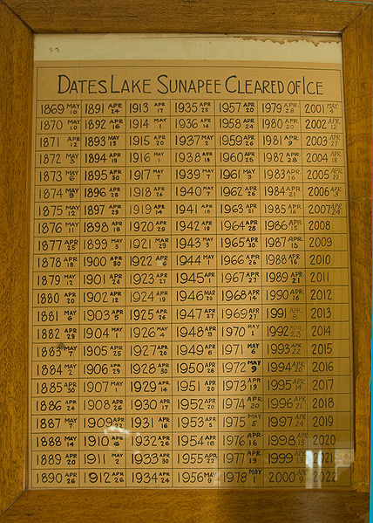
Lake Sunapee, New Hampshire, dataset
Day of year: 01-Jan = 1
31-Dec = 365
Photo credit: Joseph Brophy

Slide 13
Graphing Sunapee dataset

Slide 14
Linear regression overview
y = m*x + b
Independent variable:
Year (units=year)

Slide 15
Linear regression overview
y = m*x + b
Slope of line
(units=day of year)
‘-’ = getting earlier
‘+’ = getting later

Slide 16
Linear regression overview
y = m*x + b
Intercept
(units=year)
At x=0, what is y
Height of the line

Slide 17
Linear regression overview
y = m*x + b
Dependent variable
(units= day of year)
Day of ice-off

Slide 18
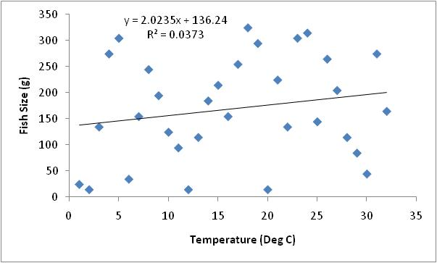
Linear regression overview
R²=proportion of variation explained
R² = 0.04
4% of variance explained

Slide 19
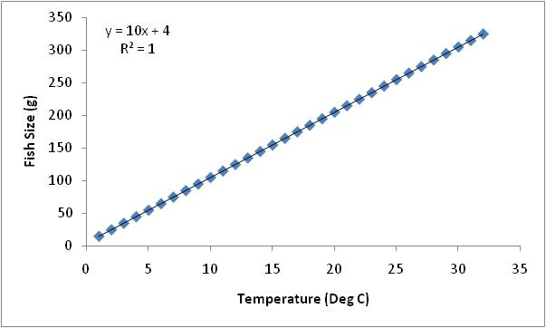
Linear regression overview
R²=proportion of variation explained
R² = 1.00
100% of variance explained,
perfect line

Slide 20
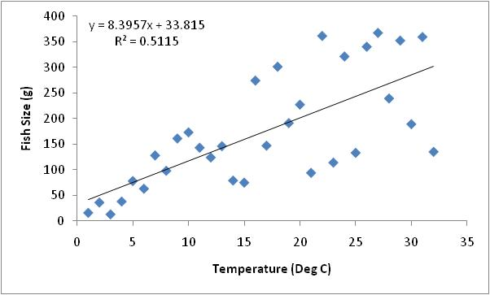
Linear regression overview
R²=proportion of variation explained
R² > 0.3
30% of variance explained

Slide 21
Graphing Sunapee dataset
Multiple regression lines; look at slope, R² (indicator of variability)
Predict Ice-out for this year!

Slide 22
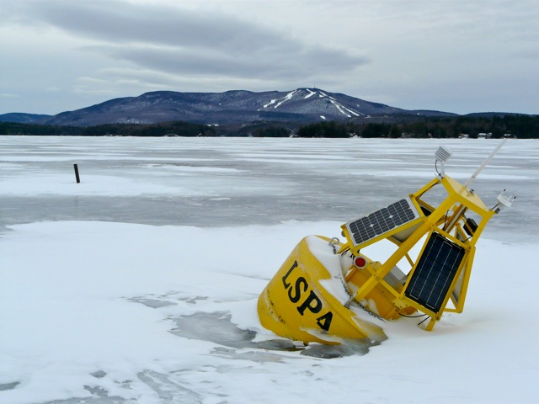
What’s our ice-off day?
Lake Sunapee, NH (Photo credit: Midge Eliassen)

Slide 23
Class activity
Divide into groups; pick a lake (not Sunapee!)
Graph regression line for entire dataset
Calculate ice-off day with regression equation for beginning and end of dataset
Predict ice-off day for this upcoming spring
Why is there so much variability in the data?
Why do different lakes have different patterns?

Slide 24
Lake Metadata
Lake Name | Location | Latitude (ºN) | Lake area (km²) | Trophic status
Baikal | Siberia, Russia | 53 | 31,722 | Oligotrophic
Cazenovia | Near Syracuse, NY, USA | 42 | 4.5 | Eutrophic
Mendota | Madison, WI, USA | 43 | 39 | Eutrophic
Monona | Madison, WI, USA | 43 | 13 | Eutrophic
Oneida | Near Syracuse, NY, USA | 43 | 207 | Mesotrophic
Sunapee | Central NH, USA | 43 | 17 | Oligotrophic
Wingra | Madison, WI, USA | 43 | 1 | Eutrophic

Slide 25
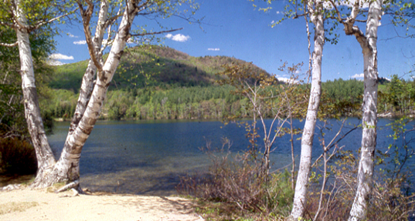
Mirror Lake, New Hampshire
Photo credit: hubbardbrook.org

Slide 26
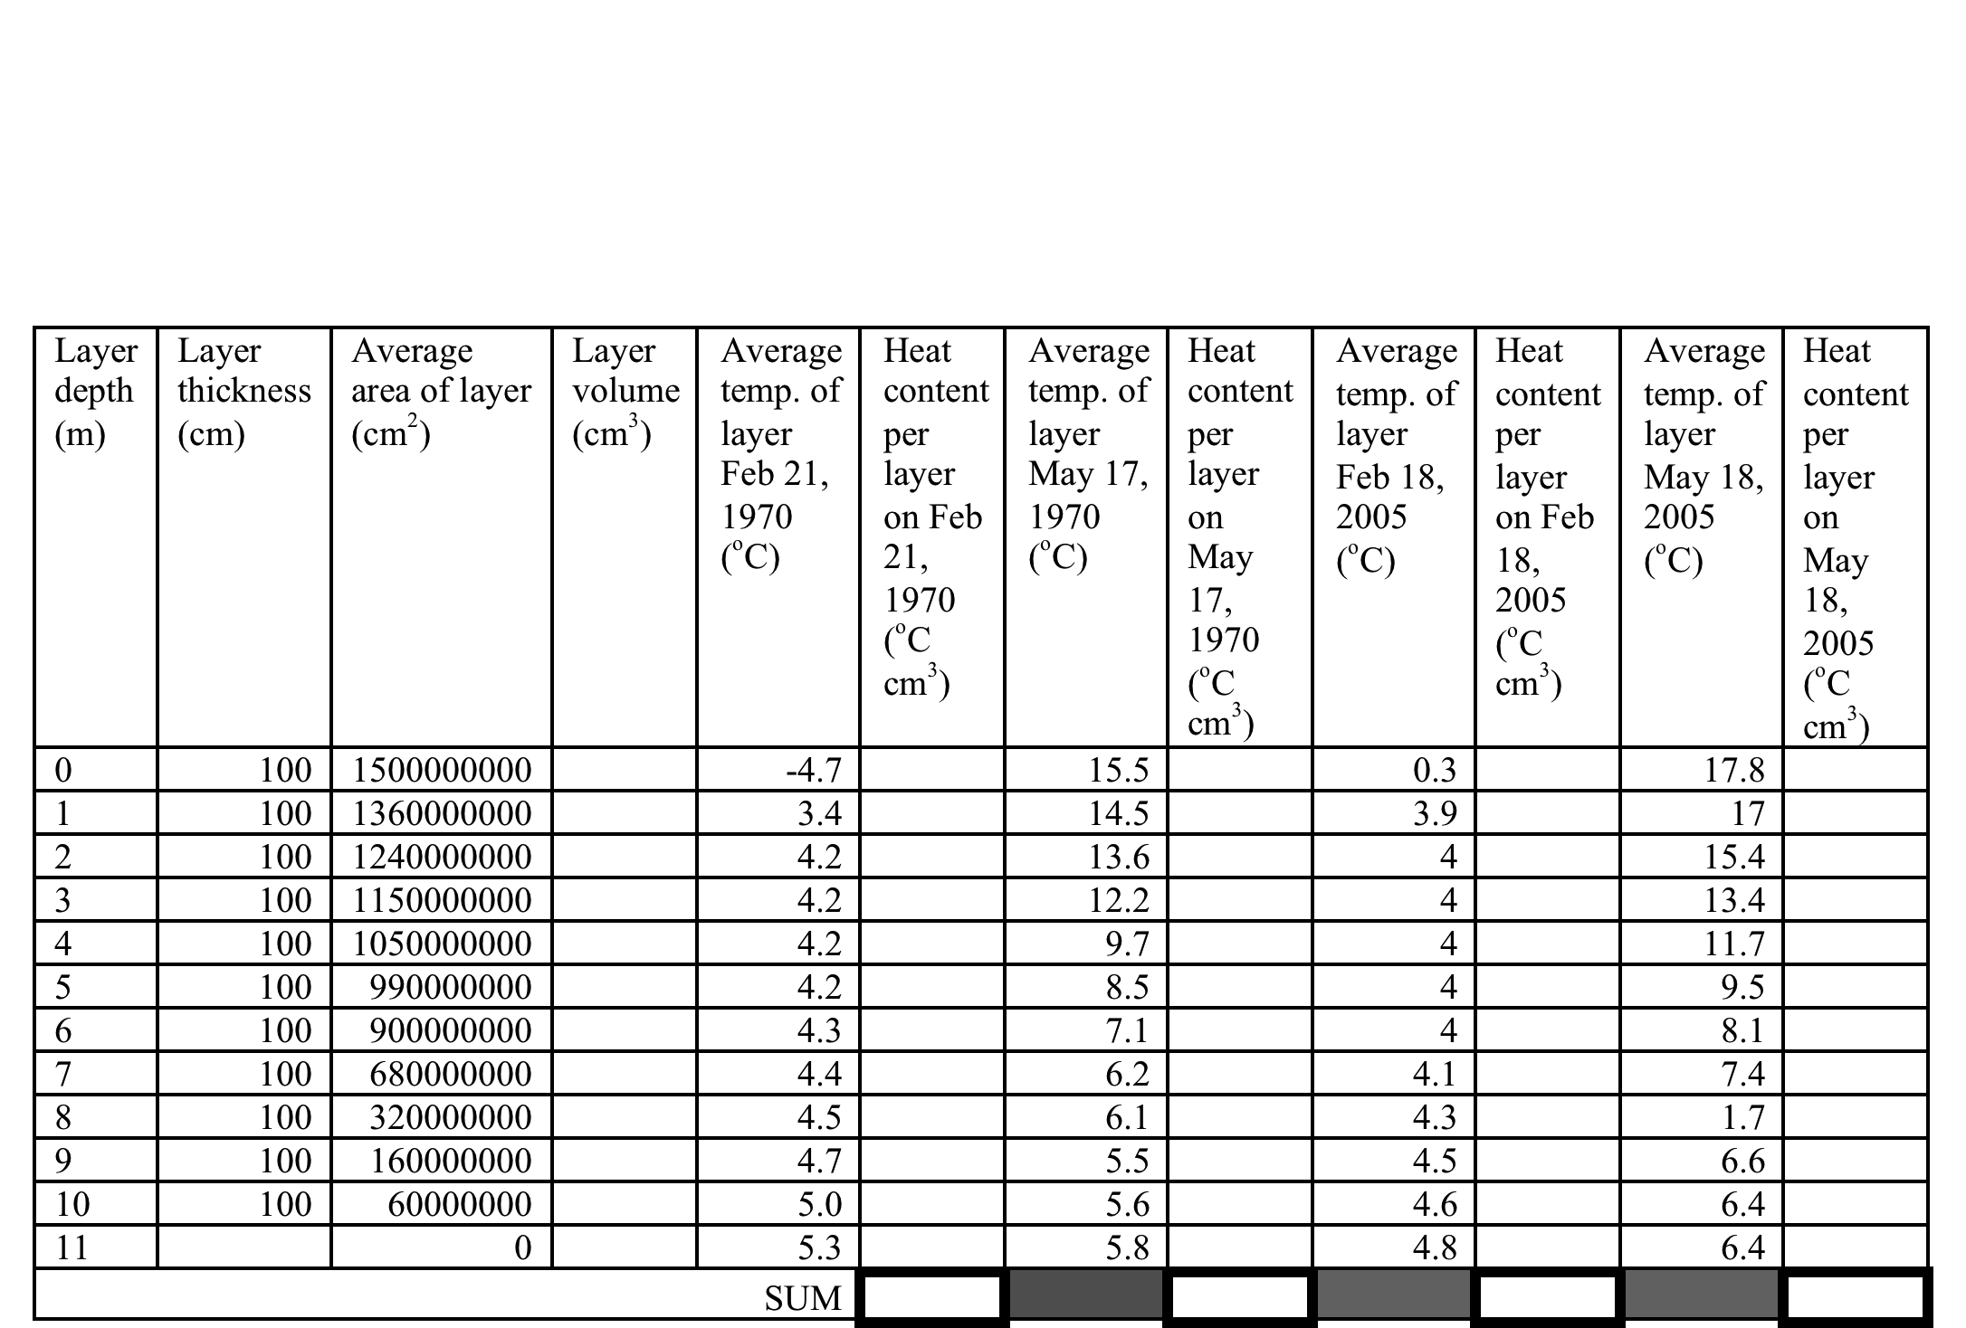
Homework Table

